Slide 1
Integrated Climate Change Adaptation (CCA) and Flood Risk management Strategy and Plan for the Drin River Basin
Draft
Transboundary FRM Action Plan Drin River Basin 2025 - 2035
Sept. 2024

Slide 2
Table of Contents
Action Plan Lower Drin
Action Plan Medium Skadar/Shkoder Lake
Action Plan Medium Drin Cascade
Action Plan White Drin
Action Plan Upper Lakes
Summary of Specific FRM Actions

Slide 3
Action Plan Matrix
Action Plan matrix is subdivided for each macro area into three (3) tables, which include FRM categories and the key elements of the FRM Action Plan.
FRM Action Plan - Axis of Action n° I- “Strategic Objective 1 - Ensure Flood Risk Awareness, Prevention & Preparedness”
FRM Action Plan - Axis of Action n° II – “Strategic Objective 2 - Environmental & no-regret Approach to FRM”
FRM Action Plan - Axis of Action n° III – “Strategic Objective 3 - Bottom-Up & Participatory Approach”
Priority level of the FRM Category was highlighted using the following conventions: High Priority (Yellow), Medium Priority (Pink), and Low Priority (Green).

Slide 4
Action Plan Lower Drin

Slide 5
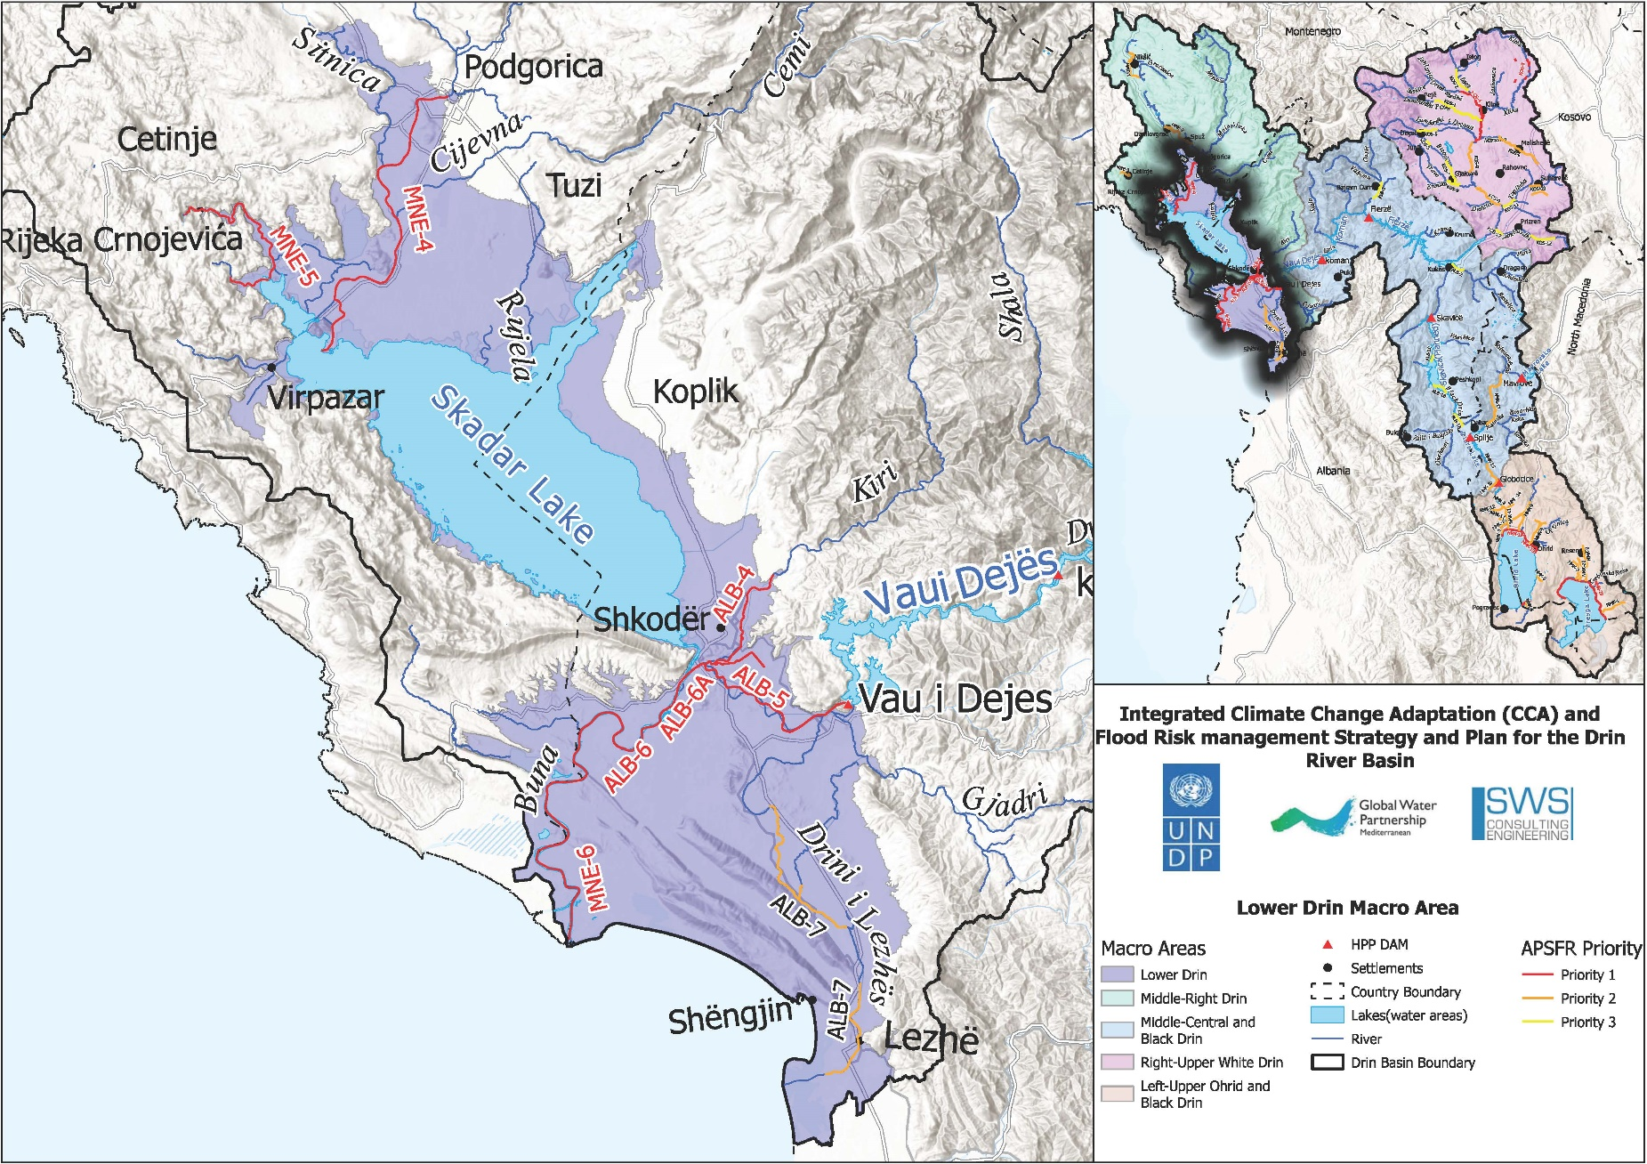
Lower Drin

Slide 6
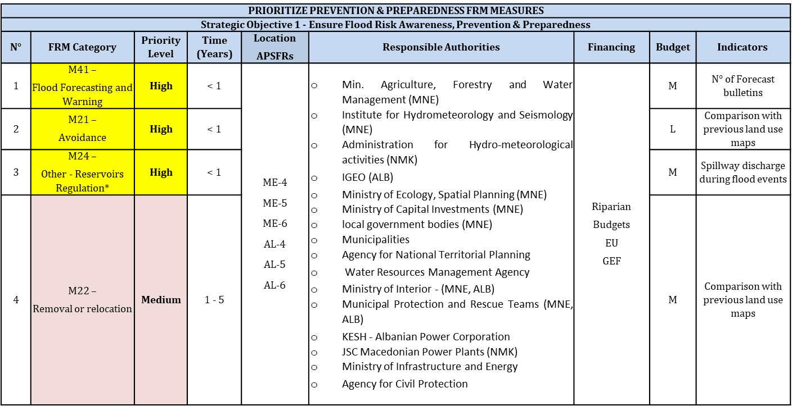
Lower Drin: FRM Action Plan - Axis of Action n° I

Slide 7
Specific FRM Actions (Axis of Action n° 1) – Albania/Montenegro
M41 – Flood Forecasting and Warning
Continuous Improvement of flood forecast and flood warning
Development of the basin wide EWS based on the Drin riparian’s improvements in flood forecast and flood warning
M21 – Avoidance
Spatial/Urban Planning: Integrate flood risk analysis into urban/territorial planning, with building restrictions in high-risk areas.
Flood Proofing: Develop flood-resilient urban infrastructure and define mandatory precautions for building protection.
Risk Communication: Disseminate flood risk maps and information to urban planners and administrations through seminars and meetings.
Construction Guidelines: Draft guidelines for construction and land use, limiting development in risk areas.
Plan Reviews: Update local development plans to include flood risk management measures.
Construction Control: Establish mechanisms to control and limit new constructions in flood-prone areas.
Support for Illegal Constructions: Assist residents with illegal buildings to relocate from high-risk zones.
Wetland and Agricultural Land Protection: Ensure appropriate use of agricultural land and prevent construction in wetland and floodplains, particularly in areas like the Viluni channel and Kir River.

Slide 8
Specific FRM Actions (Axis of Action n° 1) – Albania/Montenegro
M24 – Other - Reservoirs Regulation
Flood Risk Mapping and Studies: Conduct studies and mapping of flood risk areas, particularly focusing on reservoirs and their regulation.
Set the Regulation of Reservoirs in Vau I Dejes and Koman for Flood Risks
Construct Skavica Dam
Flood Protection Areas: Identify areas of interest for flood protection and adapt areas of mutual importance accordingly.
Coordination in International Basins: Coordinate with international partners on Areas with Potentially Significant Flood Risk (APSFR) in shared basins.
Preparation of further hydromorphological studies covering the area of Lake Skadar and the Bojana River in order to assess possible measures to reduce the negative impacts of floods caused by heavy rainfall and the rise in the level of Lake Skadar.

Slide 9
Lower Drin: FRM Action Plan - Axis of Action n° II

Slide 10
Specific FRM Actions (Axis of Action n° 2) – Albania/Montenegro
M31 – Natural flood management
Revitalization of River Beds and Banks: Afforestation along mountain streams and riverbanks (Kir and Buna Rivers) using indigenous hydrophilic vegetation to reduce erosion and enhance water discharge.
Changing River Courses: Adjust obstacles (like constructions) in canals to increase transport capacity and extend discharge capacity through international agreements (Belaj bottleneck in Buna River).
Construction of embankments and pumping stations (Kuç village) to manage floodwaters.
Protection of Riverbank Zones:Clean riverbeds and banks (Kir River) and define disposal areas for solid inert materials to avoid water pollution.Build green belts along streams (Pistalli Stream) and protect riverbanks with vegetation (Drin and Buna Rivers).
Support of Natural Floodplains:Promote sustainable livestock grazing and improve forest vegetation (Velipoja area) in floodplains to protect soil and reduce erosion.
Modified Extensive River Maintenance:Reconstruct the Buna Riverbed from Bahçallek to the Estuary.

Slide 11
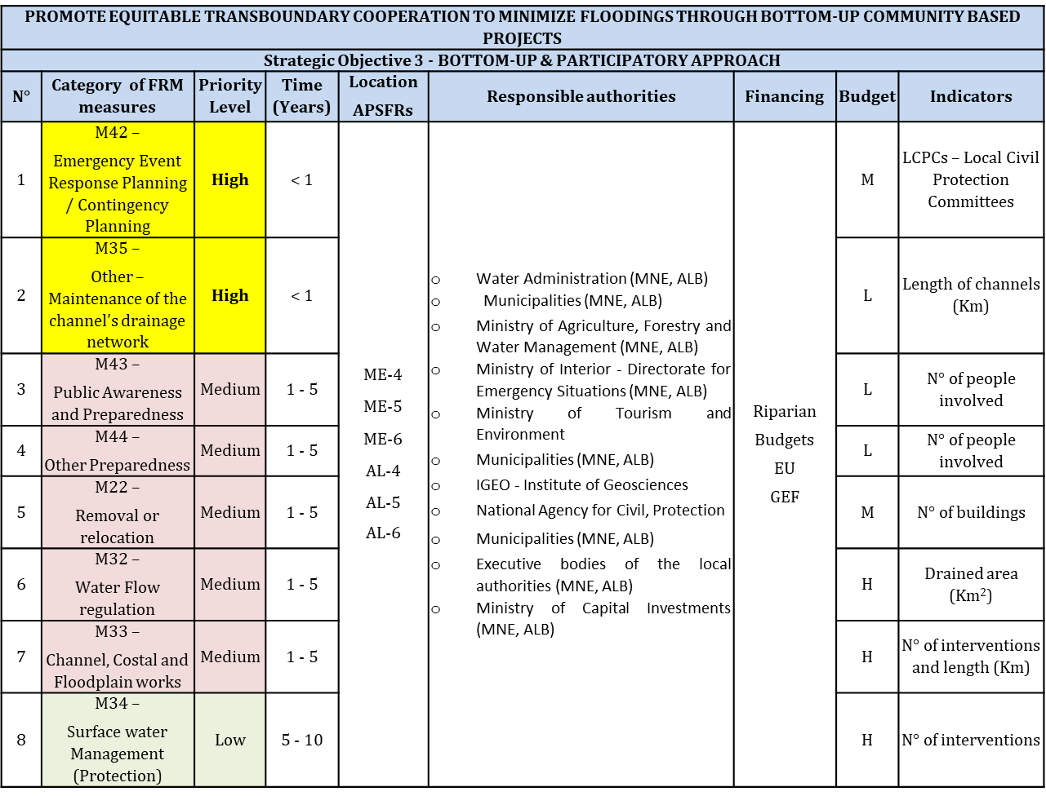
Lower Drin: FRM Action Plan - Axis of Action n° III

Slide 12
Specific FRM Actions (Axis of Action n° 3) – Albania/Montenegro
M42 – Emergency Event Response Planning / Contingency planning
Financial Preparedness: Promote insurance against natural hazards in high-risk areas through technical seminars with insurance companies.
Resident Awareness: Raise awareness of flood insurance for property owners in flood-prone areas.
Civil Protection Plans: Prepare evacuation maps, train communities for emergencies, and construct first-aid stations (pods) for livestock and people during floods.
Alarm System Maintenance: Ensure the maintenance of the alarm system by KESH for high-risk flood areas.
Monitoring and Forecasting Systems: Maintain hydrometeorological systems in the Drin River cascade.
Evacuation Tools: Provide and maintain safe mobility means (metal boats, etc.) for evacuation.
Supporting development of joint protection and rescue plans in flood events between municipalities.
Supporting joint simulation exercises of response in flood events among various stakeholders.
Identification of areas of interest for flood Protection - Consideration of proposals and adaptation of areas of mutual importance for flood protection
M35 – Other – Maintenance of the channel’s drainage network
Maintenance of embankments: Regular checks of embankments to ensure stability and functionality.

Slide 13
Action Plan Medium Skadar/Shkoder Lake

Slide 14
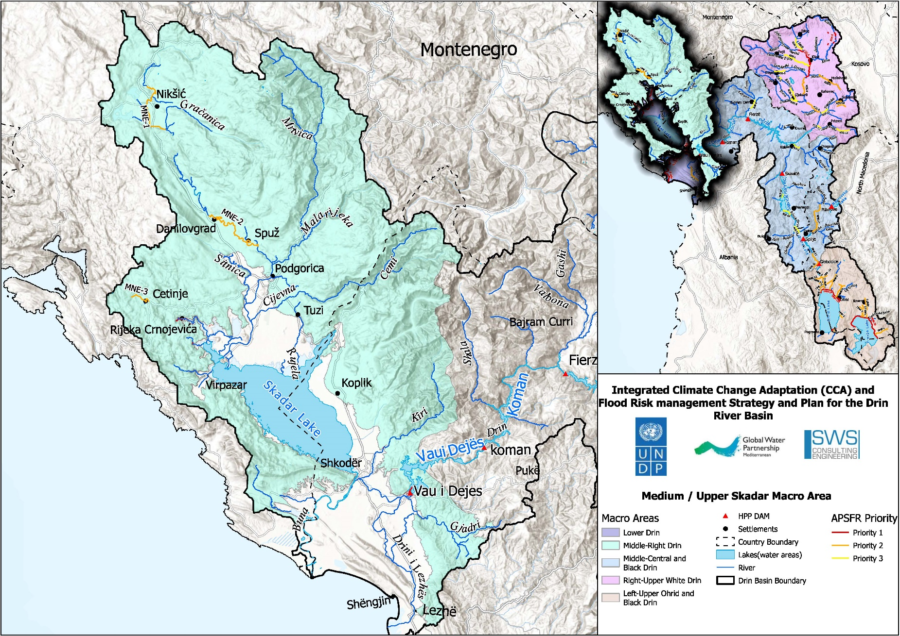
Medium Skadar/Shkoder Lake

Slide 15
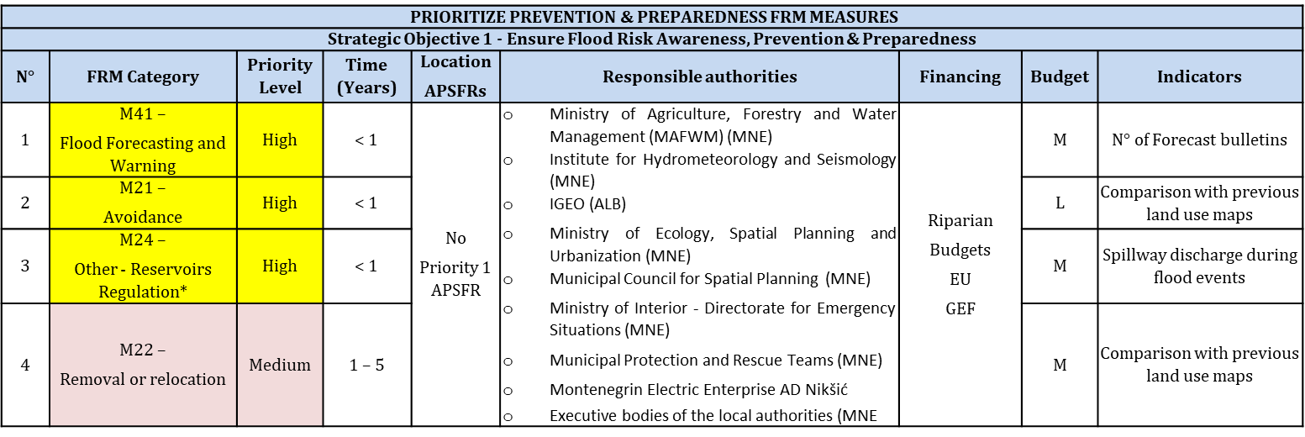
Medium Skadar Lake: FRM Action Plan - Axis of Action n° I

Slide 16
Specific FRM Actions (Axis of Action n° 1) – Albania/Montenegro
M41 – Flood Forecasting and Warning
Continuous Improvement of flood forecast and flood warning
Continuous improvement of the system for hydrological and meteorological observations including measurements of groundwater level and data transfer systems resulting in the process of setting up the early warning system.
Development of the basin wide EWS based on the Drin riparian’s improvements in flood forecast and flood warning
M21 – Avoidance
Restriction for building in risk areas (in spatial planning / urban planning), Integrated urban planning towards flood resilient facilities; provide flood proofing for the most affected urban areas.
Protection of the flood plains and retention areas

Slide 17
Specific FRM Actions (Axis of Action n° 1) – Albania/Montenegro
M24 – Other - Reservoirs Regulation
Mapping of flood risk areas.
Development and approval of Local FRM Plan
Implementation of Hydrogeological investigations in order to define the dimensions and spatial position of the revealed karst channels and their hydrological function (APSFR 03 – Cetinje field MNE)

Slide 18
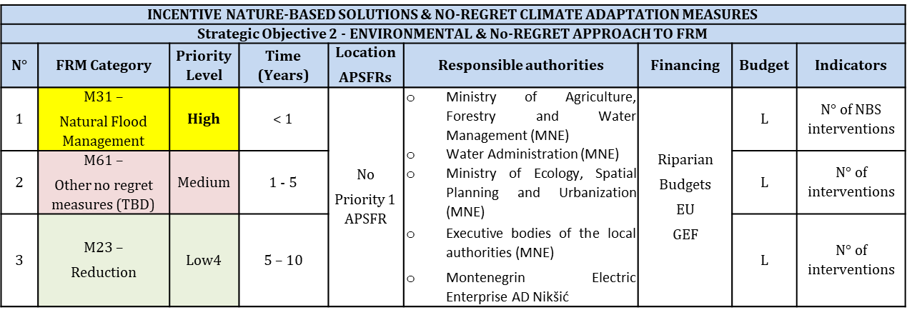
Medium Skadar Lake: FRM Action Plan - Axis of Action n° II

Slide 19
Specific FRM Actions (Axis of Action n° 2) – Albania/Montenegro
M31 – Natural flood management
Revitalization of river beds and river banks / former flood plains
Protection of zones along river banks
Support of the development of natural floodplains

Slide 20
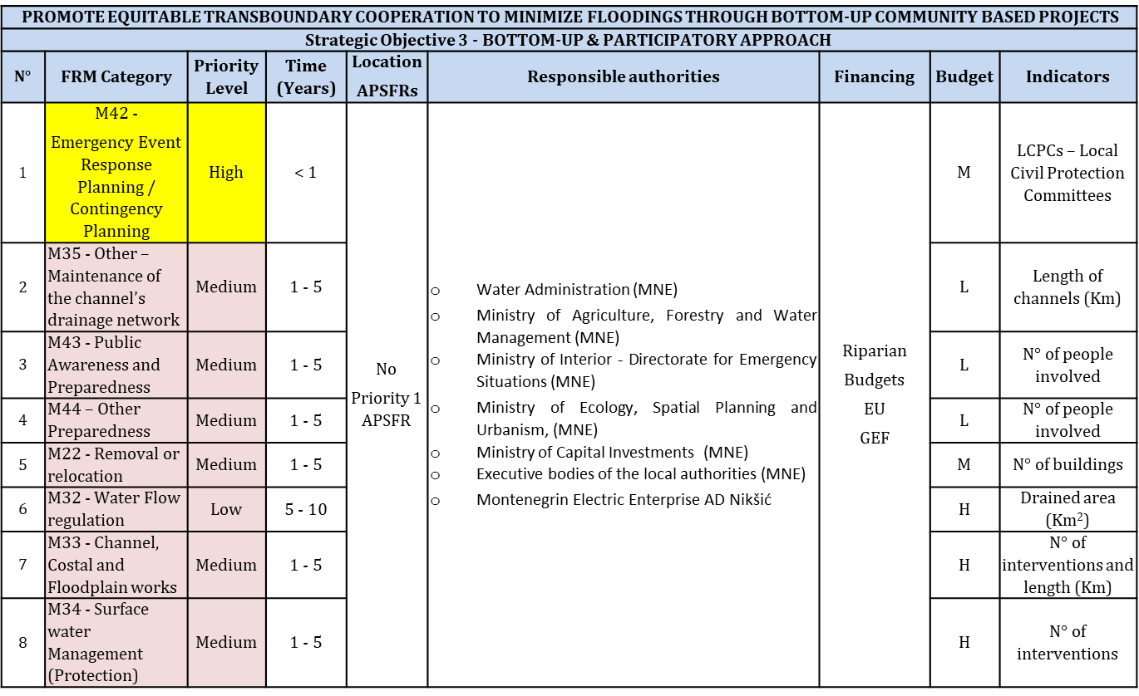
Medium Skadar Lake: FRM Action Plan - Axis of Action n° III

Slide 21
Specific FRM Actions (Axis of Action n° 3) – Albania/Montenegro
M42 – Emergency Event Response Planning / Contingency planning
Financial precautions by reserves and insurances (insurance against natural hazards).
Civil Protection.
Alignment or optimization of alert and operation schemes (disaster management schemes).

Slide 22
Action Plan Drin Cascade

Slide 23
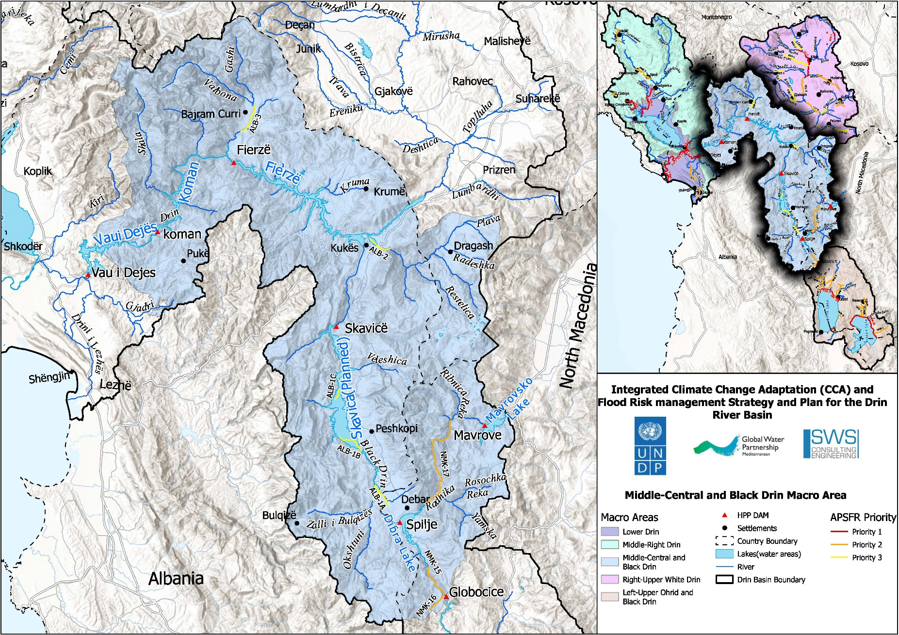
Drin Cascade

Slide 24
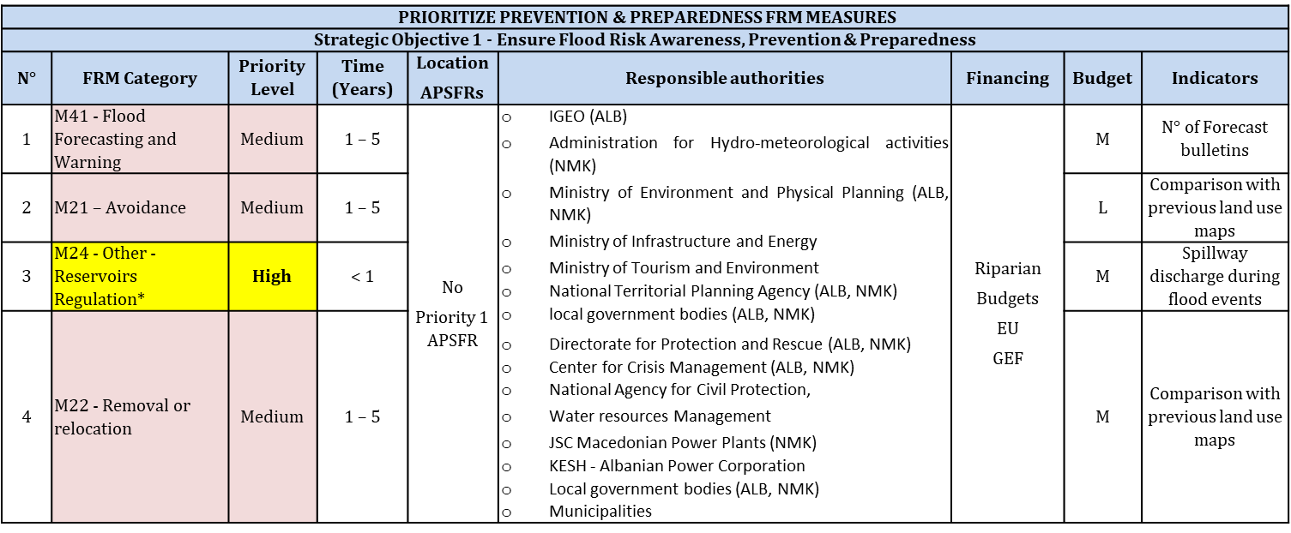
Drin Cascade: FRM Action Plan - Axis of Action n° I

Slide 25
Specific FRM Actions (Axis of Action n° 1) – Albania/North Macedonia
M24 – Other – (Reservoirs Regulation*)
Set the Regulation of Reservoirs in Fierza, Vau i Dejes , Koman for Flood Risks
Construct Skavica Dam
Awareness-raising projects in high schools and secondary Schools
Carry out regular updates of Hazard and Risk maps according to the legal provision or in cases when significant changes occur that need to be considered and integrated / further development of database
Provision of digital flood hazard and risk maps based on a web-GIS platform to facilitate decision-making on flood risk management (including regular updating).
Distribution of information leaflets, including flood risk maps and guidance information for the population in case of emergency (combined with measure 4.4.1-1 related with evacuation maps/points/streets in case of emergency)
Distribution flood risk maps in the local administration at all levels
Maintaining, supplementing and updating on the websites of central and local institutions information on flood risk management, self-protection, flood hazard maps, flood risk assets, new flood events, water access levels and relevant scenarios for each area, and interactive guidance.

Slide 26
Drin Cascade: FRM Action Plan - Axis of Action n° II

Slide 27
Specific FRM Actions (Axis of Action n° 2) – Albania/North Macedonia
M31 – Natural flood management
Afforestation along mountain streams
Adjustment and cleaning of obstacles (constructions, crossings, tombs)
Compilation of studies in order to determine the areas where river inerts may or may not be used to reduce the effects of floods and use their conclusions as mandatory guidelines for implementation
Education / cooperation with landowners or land users to encourage livestock integration Improvement of forest vegetation in areas of alluvial plains by planting autochthonous hydrophilic seedlings with strong root system
Planting willows, acacias and poplars in the areas along the river side to reduce erosion
Environmental assessment of flooded areas, to guide re sponsible institutions to assess the environmental situation before land use decisions etc., not just after a flood.
Reconstruction of the riverbed

Slide 28
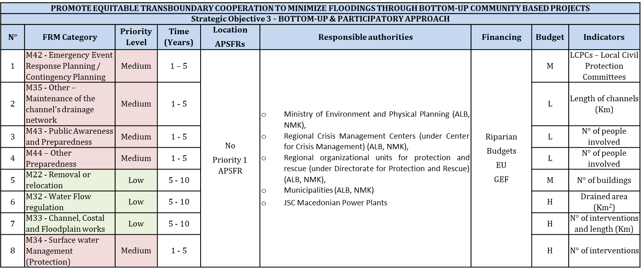
Drin Cascade: FRM Action Plan - Axis of Action n° III

Slide 29
Action Plan White Cascade

Slide 30
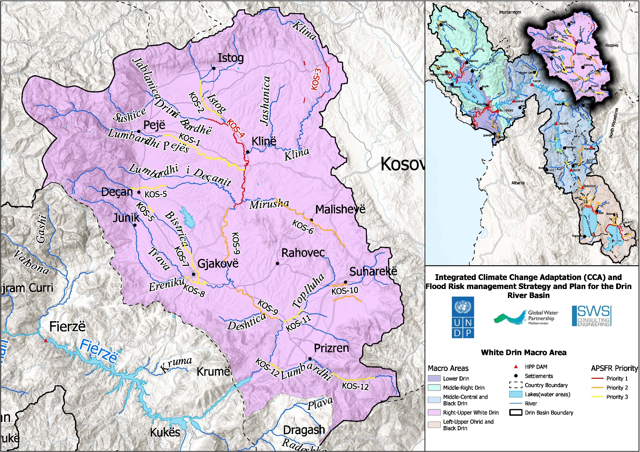
WHITE DRIN MACRO-AREA

Slide 31
White Drin: FRM Action Plan - Axis of Action n° I

Slide 32
Specific FRM Actions (Axis of Action n° 1) – Kosovo
M21 – Avoidance
Spatial plans shell includes information presented on the hazard and risk maps regarding the flood spatial distribution, in order to prevent the construction of any buildings and urbanization in areas that are at risk of flooding.

Slide 33
White Drin: FRM Action Plan - Axis of Action n° II

Slide 34
Specific FRM Actions (Axis of Action n° 2) – Kosovo
M31 – Natural flood management
Afforestation along mountain streams
Adjustment and cleaning of obstacles (constructions, crossings, tombs)
Compilation of studies in order to determine the areas where river inerts may or may not be used to reduce the effects of floods and use their conclusions as mandatory guidelines for implementation
Education / cooperation with landowners or land users to encourage livestock integration Improvement of forest vegetation in areas risked from flood
Planting willows, acacias and poplars in the areas along the river side to reduce erosion
Environmental assessment of flooded areas, to guide re sponsible institutions to assess the environmental situation before land use decisions etc., not just after a flood.
Reconstruction of the riverbed

Slide 35
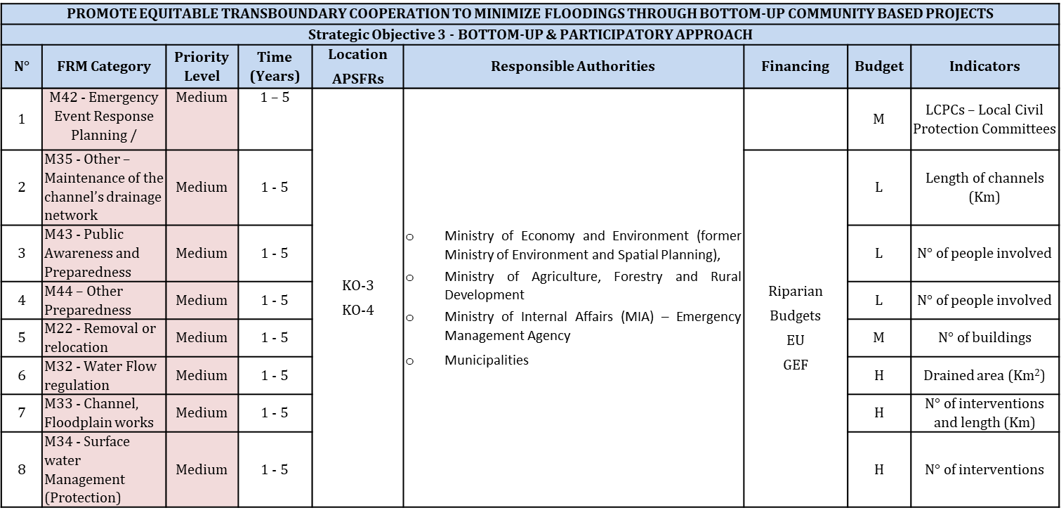
White Drin: FRM Action Plan - Axis of Action n° III

Slide 36
Action Plan Upper Lakes

Slide 37
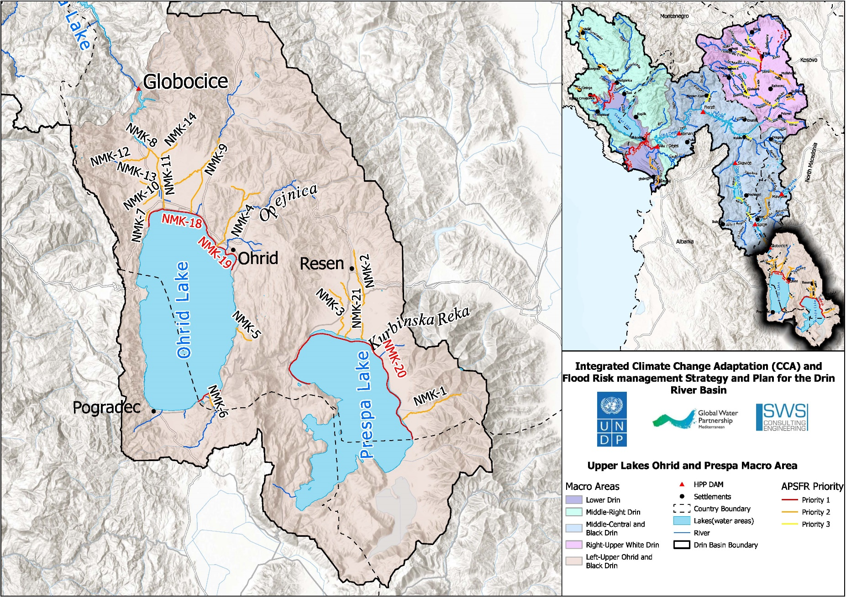
UPPER LAKES MACRO-AREA

Slide 38
Upper Lakes: FRM Action Plan - Axis of Action n° I

Slide 39
Specific FRM Actions (Axis of Action n° 1) – North Macedonia/Albania
M41 – Flood Forecasting and Warning
Continuous Improvement of flood forecast and flood warning –
Further development of early warning systems specifically addressing flash floods resulting from intense rainfall, with a small spatial and temporal scale.
Development of the basin wide EWS based on the Drin riparian’s improvements in flood forecast and flood warning
M21 – Avoidance
Restriction for building in risk areas (in spatial planning / urban planning), Integrated urban planning towards flood resilient facilities; provide flood proofing for the most affected urban areas.s

Slide 40
Upper Lakes: FRM Action Plan - Axis of Action n° II

Slide 41
Specific FRM Actions (Axis of Action n° 2) – North Macedonia/Albania
M31 – Natural flood management
Afforestation of eroded land
Riverbank Protection: Afforestation along mountain streams and riverbanks
Revitalization of the existing drainage network using former flood plains

Slide 42
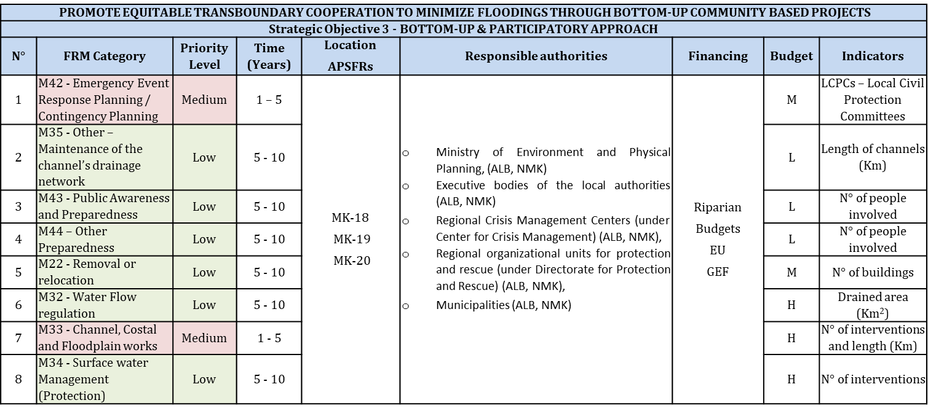
Upper Lakes: FRM Action Plan - Axis of Action n° II

Slide 43
Summary of Specific FRM Actions

Slide 44
Summary of Specific FRM Actions
Tables summarize for each axis of action / strategic objectives a Zoom-In table with a list of Specific FRM Actions to be implemented for each FRM Category, the expected outcome, and the priority level of the FRM Category for the different homogeneous flooding macro-area.
Further detail please refer to Annex VI - SPECIFIC FRM ACTIONS BY RIPARIAN COUNTRY & PRIORITY 1 – APSFRs, where the Specific FRM Actions are illustrated in details, including the Areas of Mutual Concern (Priority 1 – APSFR) and the riparian countries.

Slide 45
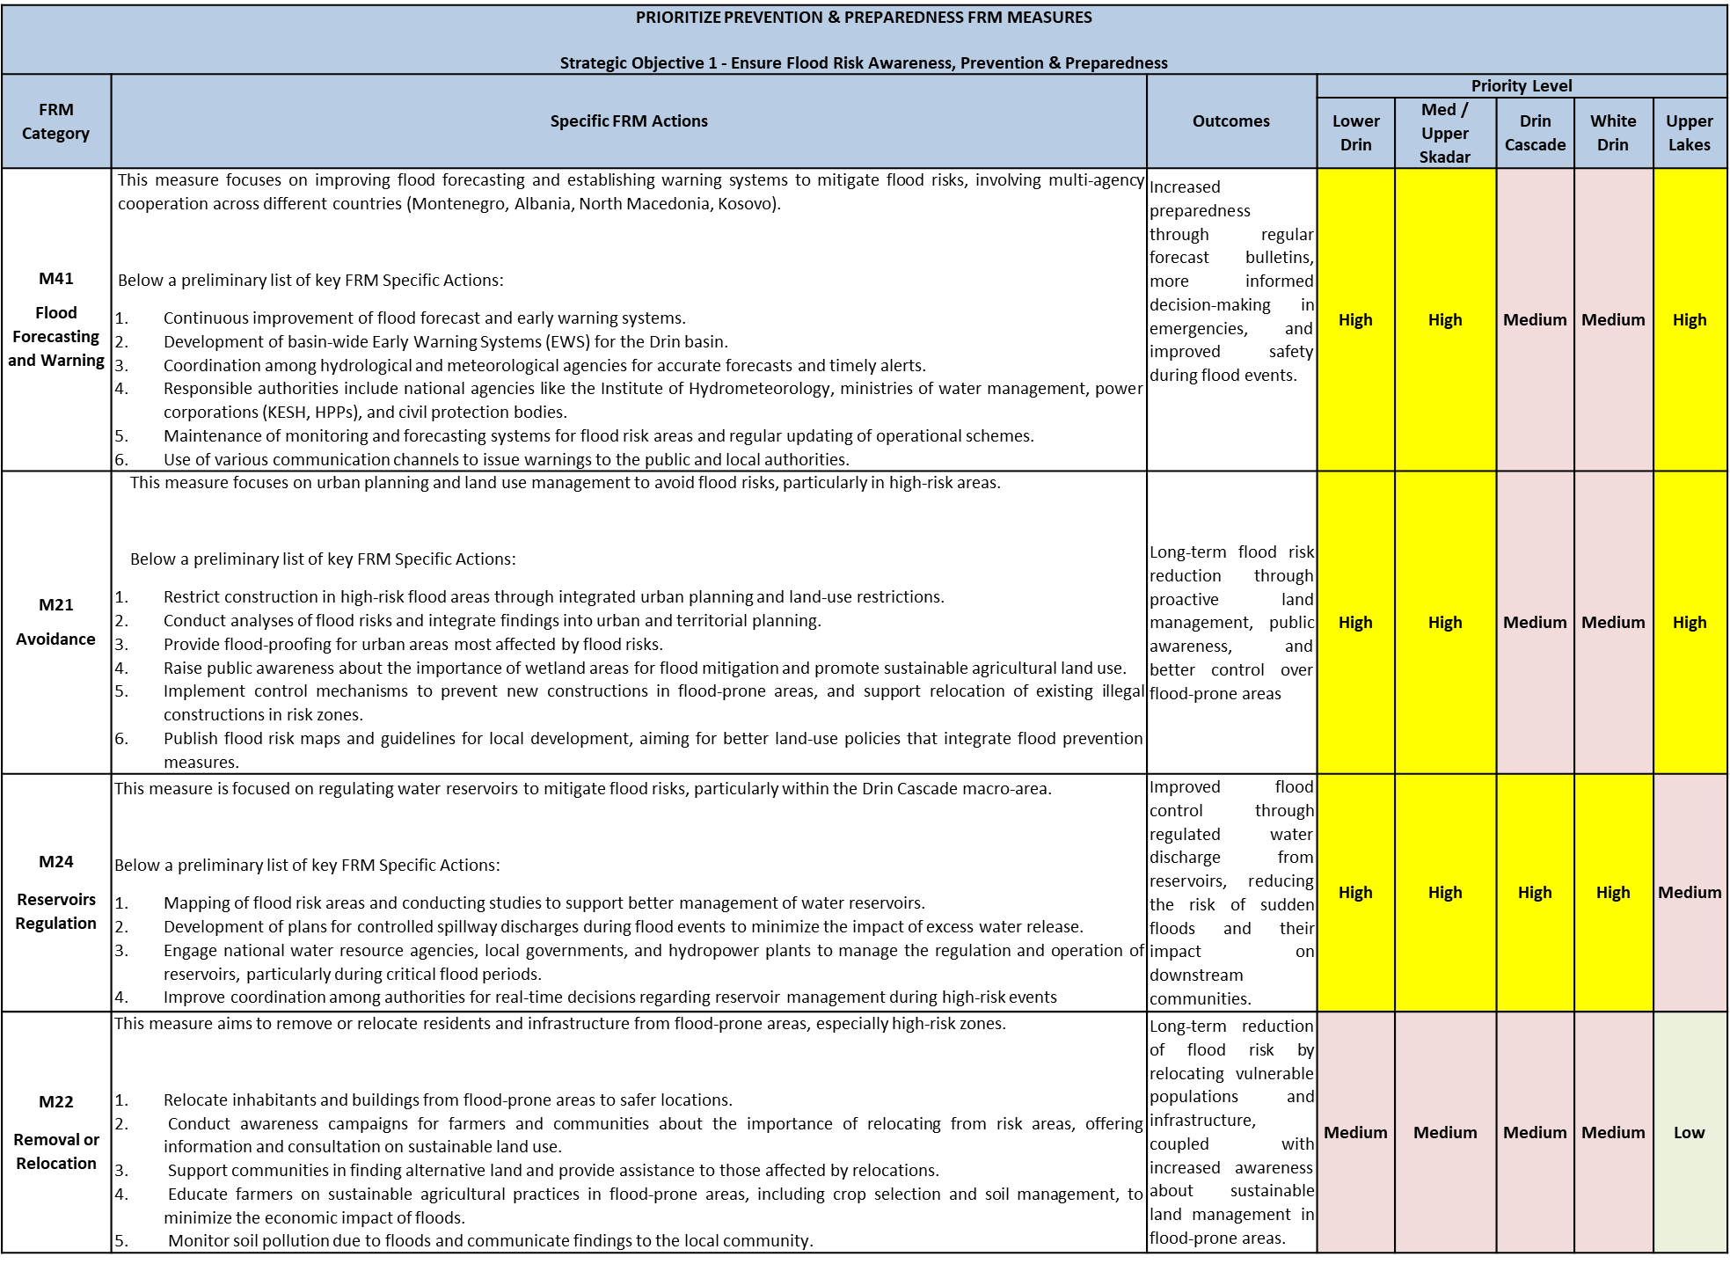
Summary Table - Axis of Action n° I

Slide 46
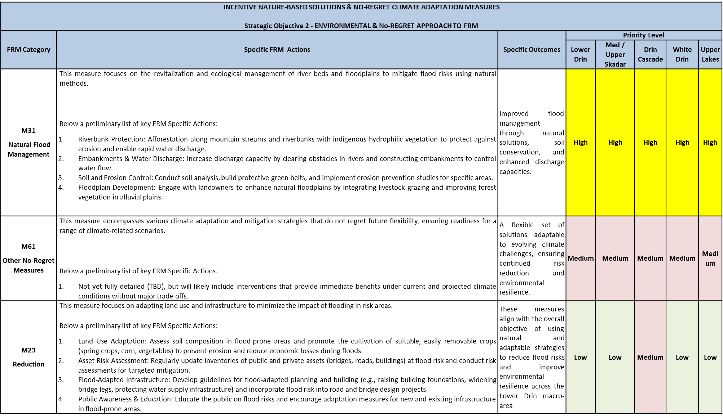
Summary Table - Axis of Action n° II

Slide 47
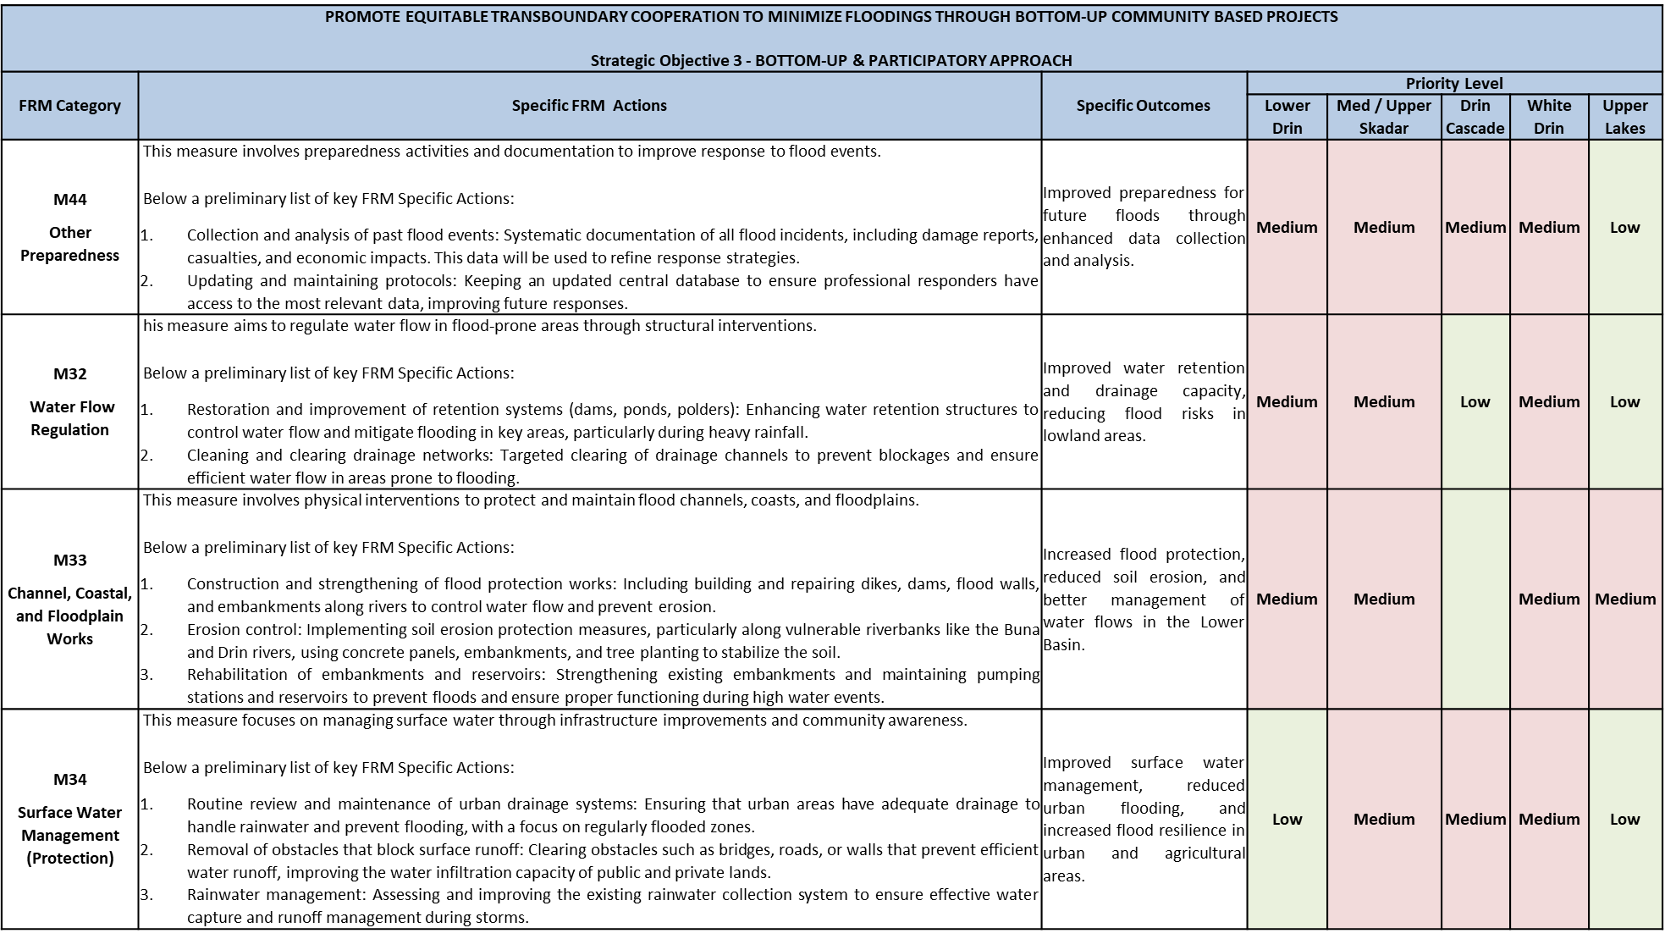
Summary Table - Axis of Action n° III

Slide 48
Summary Table - Axis of Action n° III

Slide 49
THANKS FOR ATTENTION
Doubts, Clarifications ?

